Slide 1


IS480 Mid-Term Presentation

Slide 2






Agenda
Introduction
Presenting the Project, Team and Client
Demo
Scenario run of our the Project till date
Technical Overview
The technologies we utilized, architecture and technology complexity
Quality Assurance
User testing, feedback and analysis
Project Management
Project Timeline, Change, Risk and Issues
Project Checkpoint
X-Factor, reflection and learning outcomes

Slide 3

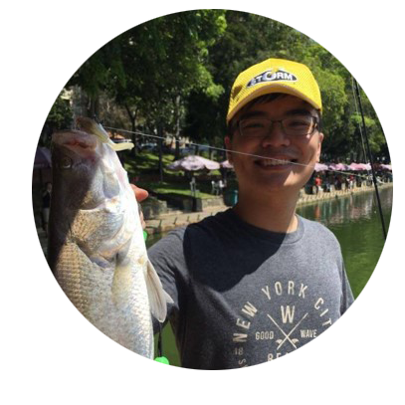
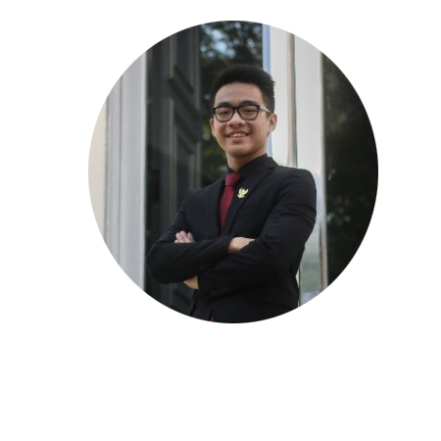


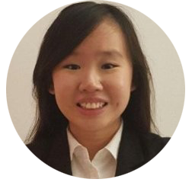
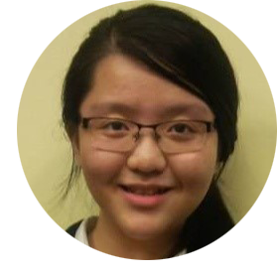
Team LeGIT
Tee Yu Xuan
Project Manager
Product Owner
Jeremy Bachtiar
Backend Developer
Scrum Team
Clarissa Poedjiono
UI/UX Developer
Scrum Master
Chen Huiyan
Frontend Developer
Scrum Team
Sheryl Chong Man Er
Quality Assurance
Scrum Team
Ong Yi Xuan
Software Architect / Deputy PM
Scrum Team

Slide 4


Our Sponsor
Grand Canyon Ltd
Founded in 1998
Soft furnishing provider with a wide range of products.
Developed capabilities in research, design, production and retail segments of the business.
More than 120 stores in 7 different cities in China, with special focus on the costal cities.
Since 2000, Grand Canyon commenced a multi-brand strategy with Mila Mila, Backyard, and Highlander London.
The newest brand from the Grand Canyon Ltd
Highlander London focuses on affluent females
Target age group between 22-55
Brand image of a classical lifestyle with comfortable living.
Working with a young designer from London to provide uniquely-designed and high quality products.
Xia Ming
General Manager
Grand Canyon Ltd
Staff & Customers
Singapore & China

Slide 5






Current Issues
Lengthy Process for Every Customer Engagement
Manual Order Entry and Tracking
Uncertain and Lengthy Order Waiting Times
Inaccurate and Poor Order Tracking for Customers
Competitors & Barriers to Entry
Difficulty Searching for
Customer Details
No way of tracking
business performance

Slide 6



Why Highlander London?
a Goal
Establish a presence and market in Singapore
a Plan
Cross-border (E)Commerce & Order Fulfilment
a Wish
Extraordinary Shopping Experience

Slide 7


Our Solution
Customers
Ecommerce Website
Order Process Tracking
QR Code Product Access
VR Product Shopping Experience
Highlander London Employees
Factory Process Management System
Order Management System
Customer Management System
Business Performance Analytics

Slide 8




Benefits of Solution
Reduced Time for Order Process
Improved Efficiency Managing Products, Customers and Orders
First Mover Advantage (New Shopping Experience)
Data Analytics supported Decision Making

Slide 9
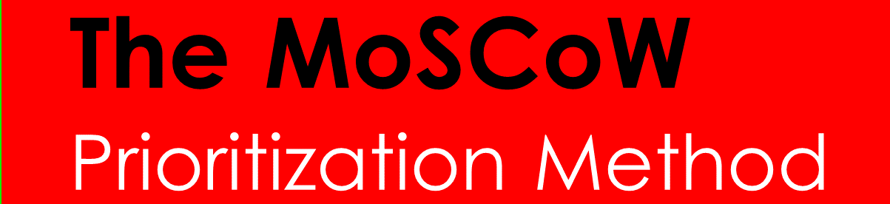




Scope
Must have requirements
Should have if at all possible
Could have but not critical
Won’t have it now, maybe if time and resource allows
Ecommerce System
Account Module
Product Module
Customization
Shopping Cart
Content Manager
Factory Process System
Order Process Management
Analytics System
Statistics & Charts
Predictions & Forecasting
Product Recommendation
Customer Profiling
VR & 3D System
Virtual Reality Product Viewing
3D Naked Eye Product Viewing (in-store only)
Commission System
Sales Staff commission and remuneration

Slide 10
Scope
Must have requirements
Should have if at all possible
Ecommerce System
Account Module
Product Module
QR Code
Filter/Sort/Search
Customization
Shopping Cart
Stripe Payment
Content Manager
Add New Products
Edit Products
Manage Customers/Staff Accounts
Factory Process System
Order Process Management
Customer Management Dashboard
Order Process Management Dashboard
Analytics System
Statistics & Charts
Descriptive Analytics on Business Performance
Predictions & Forecasting
Predictive Analytics on Demand and Consumer Trends
Customer Profiling
Supervised/Unsupervised learning to identify customer types
Product Recommendation
Based on customer profiling and business user cases

Slide 11
Scope
Could have but not critical
Won’t have it now, maybe if time and resource allows
VR & 3D System
Virtual Reality Product Viewing
Viewing of customized design on 180/360 VR
Including and excluding furniture/accessories on 180/360 VR
Naked Eye 3D Viewing
In-store viewing of 180/360 3D of customized design
Commission System
In-store Sales Staff Commission Reward System
Awards and calculates commission to sales staff that contributed to making sales within the brick-and-mortar stores.

Slide 12















Technologies
Repository
Project Management
VR System
Ecommerce System
Analytics System

Slide 13

Application Demo

Slide 14

Technical Complexity

Slide 15



As - Is Process

Slide 16



Architecture Diagram (After)

Slide 17
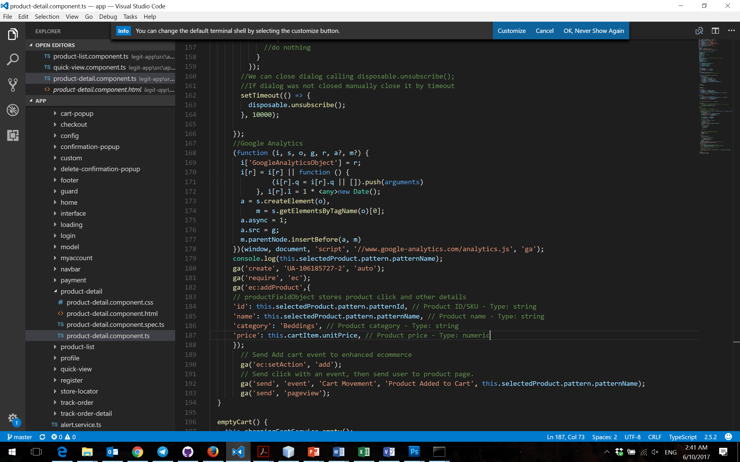
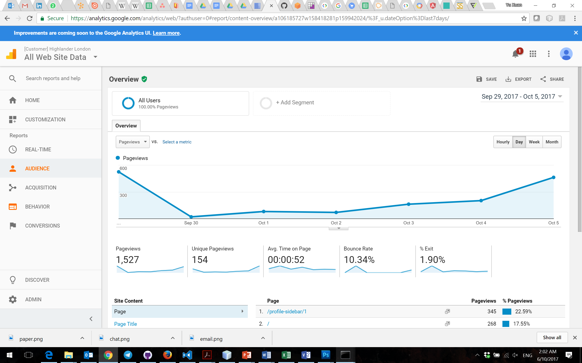


Google Analytics
Reflected on Google Analytics

Slide 18
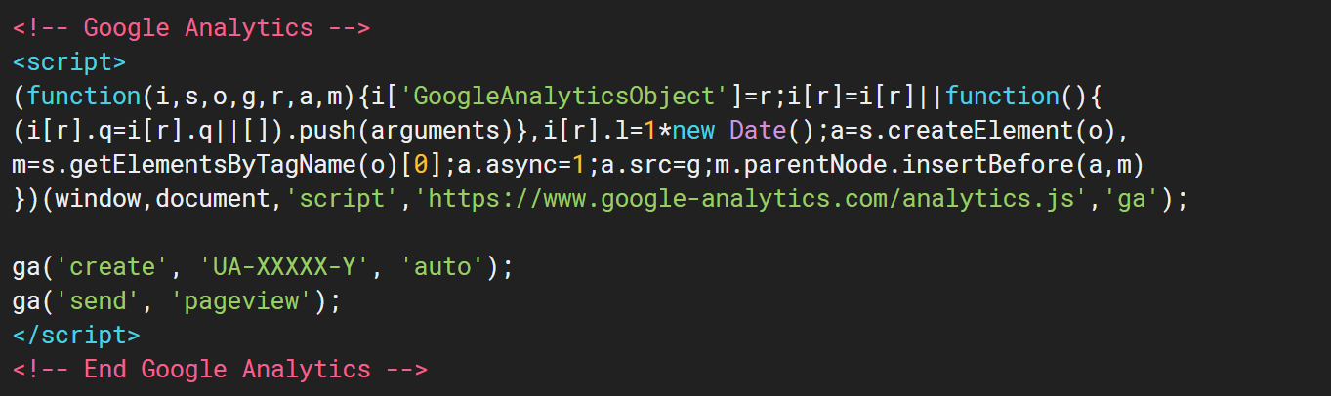
Google Analytics
Software Architecture Redesign - Embedding Google Tracker API
TOO MUCH COPY PASTING, POOR SCALABILITY
Home Page
Store Locator
Login
Product List
About Us
Product Details

Slide 19

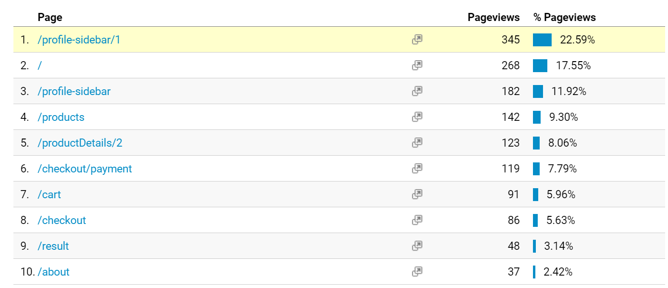
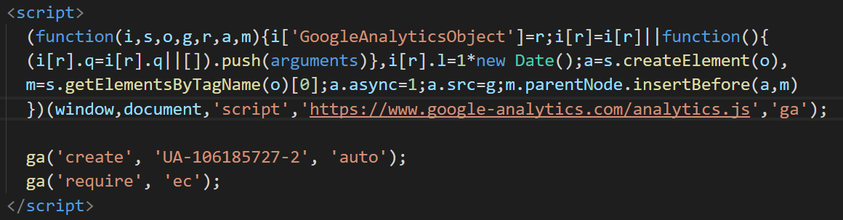
Google Analytics
Software Architecture Redesign - Embedding Google Tracker API
Smart Method
Import it in Module
Construct it in Component
Initiate it ONCE in index.html

Slide 20








Stripe Implementation
Design Methodology
Implementation of multiple payment methods
3rd Party Transaction Handler
High Security
Pop-up payment gateway, No redirects

Slide 21

Stripe Implementation
Design Methodology
Help needed on Technical Complexity ideas

Slide 22

Project Management

Slide 23




Project Status
CURRENT SPRINT
9 of 11
Functionality Completion
85%
Completion Confidence
100%

Slide 24

Timeline
Preparation (1/2)
- Sponsor Engagement - Proposal Preparation
- Creation of Wiki - Exploration of Technologies - Identifying Roles, Responsibilities and Expertise
Sprint 1
- Database Setup - Registration
- Login/Logout
- Profile Management
Sprint 3
- Product Customization
- QR Code Generator - Product Catalogue - Quick View
UAT 1
5 June
3 July
31 July
19 Aug
22 May
19 June
17 July
Preparation (2/2)
- Sponsor Engagement - Proposal Preparation - Scope Definition
- Business Process Diagram - Exploration of Technologies - Prototyping
Sprint 2
- Product Catalogue - Quick View
- Product Details - Filter/Sort/Search Product - Informational Webpages
Sprint 4
- Admin Product List - Admin Product Details - Admin Add Products
- Admin Edit Products
- AWS S3 Deployment

Slide 25
Timeline (Previous Schedule)
Sprint 7
- Analytics Dashboard Module Customer Profiling (Unsupervised Learning) Sales Analytics (Unsupervised Learning) Business Performance Charts (Descriptive Analytics) Sales and Demand Forecasting (Predictive Analytics) Web Traffic (Google Analytics)
Sprint 5
- Shopping Cart - Shipping/Payment Details
- Stripe Payment Platform
Buffer 1
Poster
30 Oct
UAT 3
UAT 4
8 Oct
5 Nov
28 Aug
25 Sept
23 Oct
12 Nov
14 Aug
11 Sept
9 Oct
Mid-Terms
Finals
Sprint 6
- Factory Order Tracking Dashboard - Production Process - Packaging Process - Shipping Process - Customer Order Tracking Dashboard - Current Order Status - Estimated Order Arrival Time
Week 8
Buffer 2
Week 14/15
Sprint 8
- Virtual Reality 3D Modelling and Customization Integration of VR on web application - Naked Eye 3D Integration of VR model on Naked Eye 3D device - Mid Term Preparation
Project Closing Preparation
- All Development Cease - Client Handover - Preparation for Finals - Documentation

Slide 26
Timeline (New Schedule)
Sprint 9 - Analytics Module Business Performance Charts Embedding of Google Analytics Chart
- Virtual Reality 3D Modelling and Customization Integration of VR on web application - Naked Eye 3D Integration of VR model on Naked Eye 3D device
Sprint 7
- Factory Order Tracking Dashboard Production Process Packaging Process Shipping Process - UI Adjustments - Promotional Code System
Sprint 5
- Shopping Cart - Shipping/Payment Details
- Stripe Payment Platform
Poster
30 Oct
UAT 3
UAT 4
8 Oct
5 Nov
28 Aug
25 Sept
23 Oct
12 Nov
14 Aug
11 Sept
9 Oct
Mid-Terms
Finals
Sprint 6
- ERD Redesign - Changing and Testing of Webservices
- Customer Order Tracking Dashboard - Current Order Status - Estimated Order Arrival Time
Week 8
Sprint 10
Week 14/15
Sprint 8
- Analytics Module Web Traffic (Google Analytics)
Product View and Click rate (Google Analytics) Enhanced Ecommerce (Google Analytics) - Mid Term Preparation
Project Closing Preparation
- All Development Cease - Client Handover - Preparation for Finals - Documentation

Slide 27
DePICT® Project Management
What is DePICT®?
The global project management methodology applied through DHL’s global businesses. (Deutsche Post DHL is the world’s largest logistics company)
Why DePICT?
Utilizing Best Practices for Project Management – DePICT is a methodology employed by DHL in all areas of businesses, from Supply Chain projects to even IT solutions.
Drive Risk Management – A disciplined approach to recognizing and managing risks before they evolve into bigger problems
Support the Business Strategy – Ensuring resources and effort are always aligned with business priorities to delivery a successful project
Keep It Simple – Easy-to-understand processes and tools in multiple areas. All team members are able to understand the content even without a user guide
How is Team LeGIT using DePICT?
Following strictly to the methodology of DePICT but making necessary adjustments to the approach to align it with the nature of the project (Excluding control tools such as investments, senior management reports and costing)

Slide 28
DePICT® Project Management
Ensuring successful project delivery
Stage | Sponsor/Business needs | Detail
Define | Clear definition of scope A common and consistent approach which reduces start-up costs and time An agreed way of working in partnership A controlled start, middle and end | Time invested up front pays-off later! Together, we determine objectives, time constraints, resources, risks, assumptions and other variables in order to clearly define the project and what it aims to achieve. Scope management is going to be prioritised using MoSCoW
Plan | Detailed plan that outlines all activities and owners Delivery of more accurate estimations Successful delivery of work which is on time and within constraints Confidence in the management and delivery of your projects | Planning represents the backbone of the project and the measure of all progress. Through discussions, we create a detailed plan with clear timelines and responsibilities that take the project from start-up to steady state.
Implement | Effective risk management Delivery of regular progress reviews against plan Effective communication that keeps you up to speed on progress Increased speed of implementation | "Monitor-Evaluate-Act" is a technique that project managers use to ensure the project remains on-track. Clear communication is particularly vital during this phase. Implementation for this project will be using Agile Scrum Methodology to answer these needs
Control | Risks are mitigated and monitored preventing them becoming issues at a later stage Specialist , reliable and stable execution Assurance that the project will add business benefits and is justified | Project manager support operations and review progress. As work proceeds, we manage risk, issue resolution, scope change, and status reporting. Control tools employed are: Risk Log, Change Log, Issue Log, Data Confidence Index.
Transition | Effective transition of the solution over to business as usual Review success criteria with our client Successful closure of project | Formal closure process. The hand-off to on-going operations management includes disciplined post-project review and analysis.

Slide 29
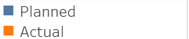
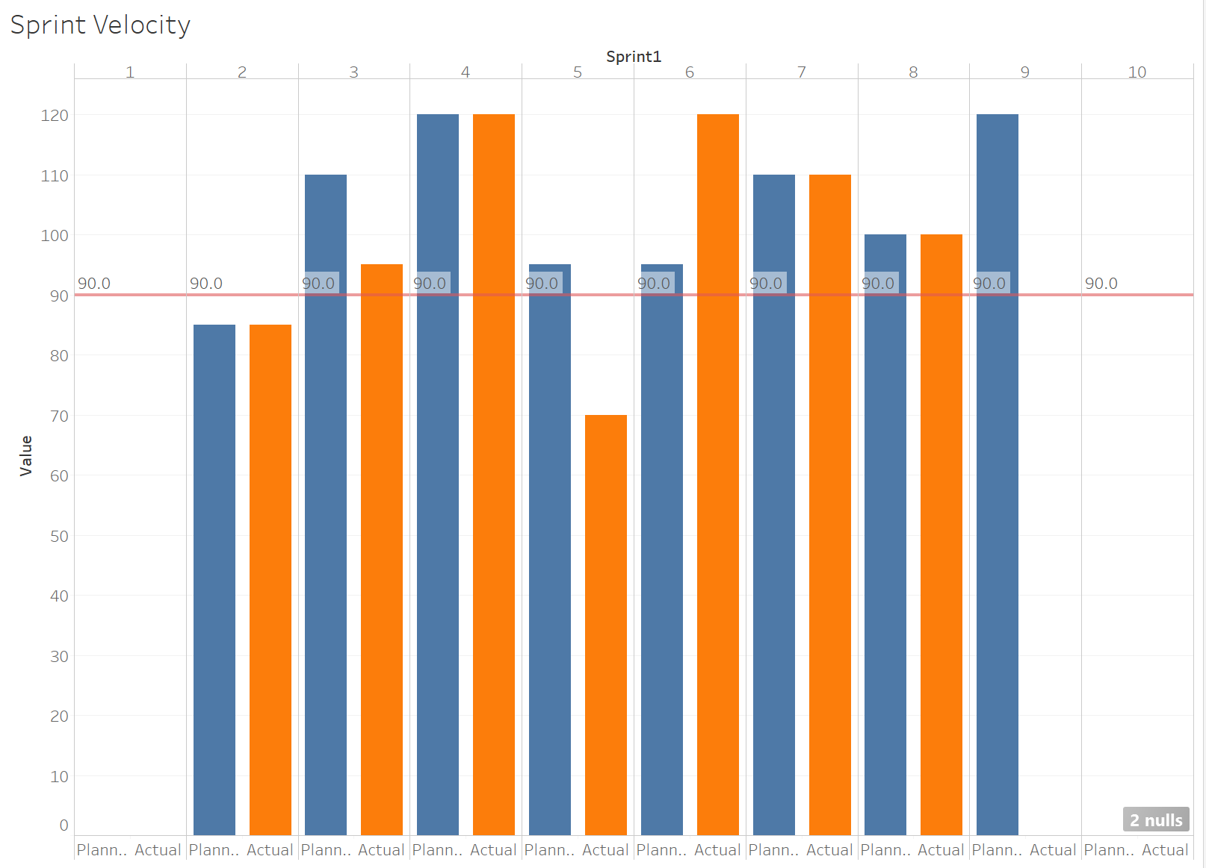
Sprint Velocity Chart
Expected Velocity
Actual/Expected Velocity | Action Item
<80% | Behind schedule, PM to review schedule, consider reducing scope
80% to 120% | Project on schedule. No action needed
>120% | Project ahead of schedule. PM to review schedule and ensure optimal resource use. Consider bringing in Won’t Haves in schedule
Velocity distributed across planned sprints to complete all scoped functions on schedule

Slide 30
Risk Management
Risks should initially be identified and assessed during the Define to Plan phases of the project.
As the project progresses, new risks will surface and the Project Manager will access it with the Team.
Medium and High severity risks are to be assigned an Owner who is responsible for the mitigation and contingency plans.
Risks are to be continually monitored by their Owners, and reviewed as a standard agenda in project team meetings.
Key risks should be reported on the Project Status Report and to the Sponsor/Supervisor.
A Risk Log is to be created and maintained by the Project Manager.

Slide 31
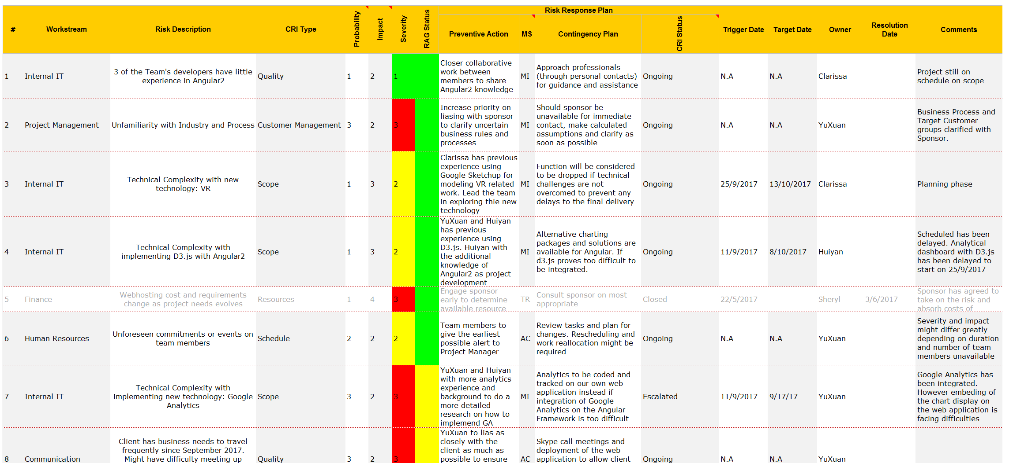
Risk Management
Risk Description | Probability | Impact | Preventive Action | Contingency Plan
Unfamiliarity with sponsor industry and process | 3 (>75%) | 3 | Increased priority on liasing with sponsor to clarify business rules and processes | Should sponsor be unavailable, make calculated assumptions and clarify as soon as possible
Technical Complexity: VR | 1 (<40%) | 2 | Clarissa has previous experience using Google Sketchup, a tool for modelling that VR uses. She can lead the team in research in this area | (Planning Phase)
Client has business needs to travel frequently in Sep 2017 | 3 (>75%) | 2 | YuXuan to lias closely with the client to know at the earliest his schedule and avoid having issues during his absence | Skype call meetings and deployment of application to allow client to communication even while overseas

Slide 32
Issue Management
An issue is something that has happened (or appears certain that it will happen) which will impact the project schedule, milestones, or other deliverables. Action must be taken to overcome the impact and minimize the effect on the project.
An Issues Log is to be created and maintained by the Project Manager.
All issues are to be logged and tracked until they are resolved.
All issues are to be assigned a single owner and due date.
Key issues that remain unresolved are to be escalated as to the Supervisor and Sponsor. A possible Change Request might be required

Slide 33
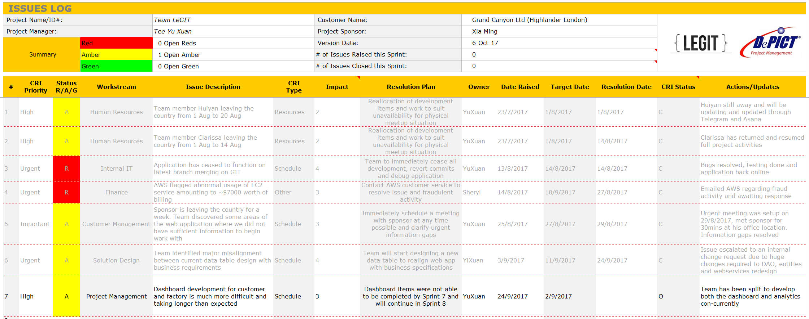
Issue Management
Issue Description | Priority | Impact | Resolution Plan | Action/Updates
Application ceased to function on latest branch merge. A day before UAT | High | 2 | Team to immediately cease all development, revert commits and debug application | Application up and running again day after. UAT with sponsor postponed to ensure fully functioning application before testing
AWS flagged fraudulent activity of EC2, billing $7000 on a student account. | Urgent | 3 | Contact AWS customer service regarding fraudulent activity access | Identified security breach in repository and applied fix. AWS replied that the amount will be waived but process will take time.
Team identified major misalignment between current data table design with business requirements | Urgent | 4 | Team will start designing a new data table to realign web app with business specifications | Issue escalated to an internal change request due to huge changes required to DAO, entities and weservices

Slide 34
Change Management
All changes are to be recorded using the Scope Change Request Form.
Each change request is to be evaluated in terms of its impact to the project’s scope, schedule and cost.
Alternative solutions (including not implementing the change) should be evaluated.
The approval status of the Scope Change Request is to be logged and tracked in the Change Log. Only approved changes will be incorporated into the project.
Scope change is to be managed by the Project Manager.
Team members are to be consulted for impact/solution evaluations.

Slide 35
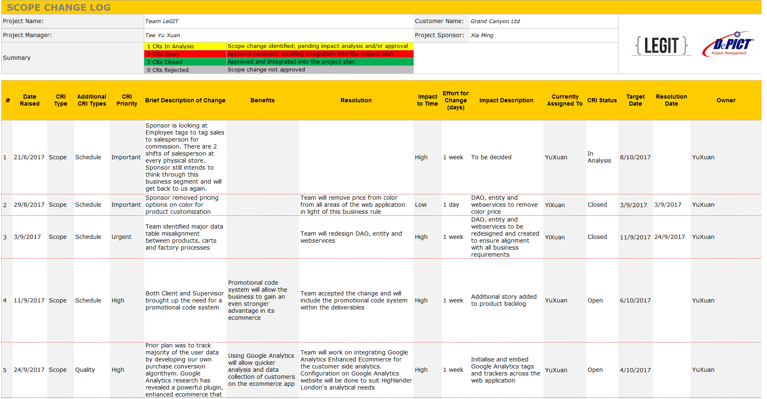
Change Management
Change Description | Impact | Benefit/Impact Description | Resolution
Sponsor removed pricing on colour options | (Low) 1 day | (Impact) Time needs to be taken off to ensure all pricing related functions are changed | Team removed price from colour tables and updated all services that involved colour price
Team identified major data table misalignment with business requirements | (High) 1 week | (Impact) Development has came to a halt to fix and test all existing webservices and entities. | Team has to halt development and resolve the misalignment of the data tables with business requirements
Team research discovered the benefits of enhanced ecommerce plugin for GA | (Low) 2 days | (Benefit) Time savings from developing similar algorithym within own app. Risk mitigation for team members inexperienced with analytics | After agreement with the client, Team decided to add tags on important areas to monitor and use GA to generate insights.

Slide 36

Quality Assurance

Slide 37
Functional Testing
Development Phase
Initial Testing
Staging Server Deployment
Live Deployment
Individual Developer will conduct testing for the functions that they developed
QA will test the functions against the test cases and log the bugs in the bug log (Asana)
Once all the bugs are resolved, QA will deploy the application on our staging server
Application is deployed live
QA will conduct regression testing to ensure no major bugs
Quality Assurance (QA) constructs test cases for all functions in the current sprint
Individual developers will debug the reported bugs
QA will conduct regression testing and log bugs in the bug log
QA will test the function and verify that the bug has been resolved
Individual developers will debug the reported bugs
QA will test the function and verify that the bug has been resolved

Slide 38


User Acceptance Testing Demographics
Potential Customers
Female
Aged 25 to 55
Highlander Employees

Slide 39
User Testing 1 Target Audience
6 Potential Customers
Female
2 Highlander Employees

Slide 40
UAT1 - Customer
Date: 20/8/2017 (Sunday)
Duration: ~30 minutes per user
Venue: Home of the customer , accompanied by one team member
Objectives:
1. To gather feedback about the usability, user interface, functions and business flow developed for the users
Identify any bugs or issues which users might face during the user testing
To detect usability issues based on users’ behaviour
4. Improve the website according to the user feedbacks

Slide 41

UAT1 – Customer Ratings
Average rating on user interface

Slide 42
UAT1 – Customer Ratings
Average rating on ease of the process of choosing the combination of the product and add the product to cart

Slide 43
UAT1 – Customer Ratings
Average rating on ease of checking out the order

Slide 44
UAT1 - Customer
Key Findings:
Participants do not know whether their products are successfully added to cart after clicking on the add to cart button.
Participants do not understand the details of the products displayed at the checkout page.
Not all participants understand the icons in the same way.
Participants tends to look towards the bottom right side of the webpage for button to proceed to the next step of checkout.

Slide 45




UAT1 – Customer Changes
Main Suggestions and Changes:
Multiple Addresses
Allow the customer to enter and store multiple addresses
Better Description of the products
To include the labels of the product information to allow the user to understand details better
Loading animations
To include loading animations to show that the page is loading
Pop out windows
To notify the customer about successful action performed

Slide 46
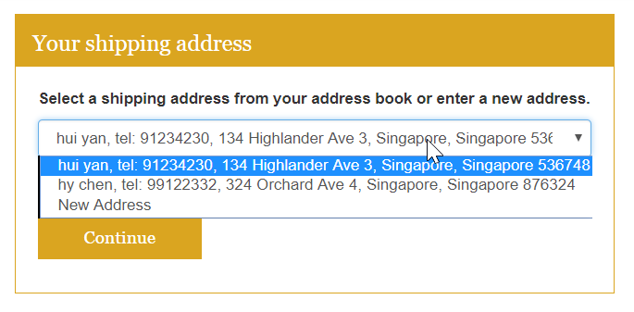
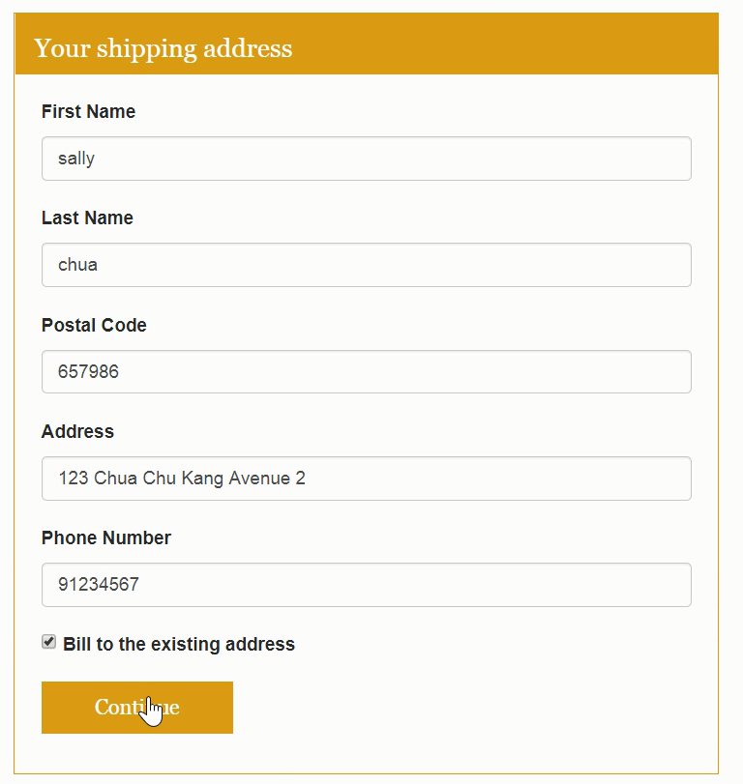
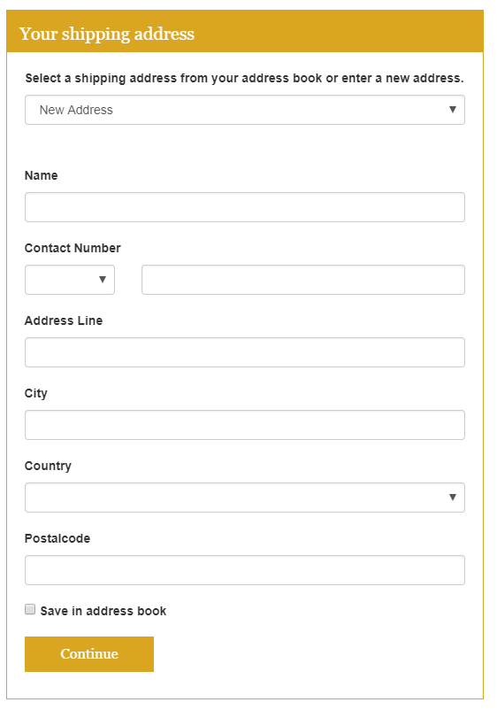
UAT1 – Customer Changes
After
Before

Slide 47
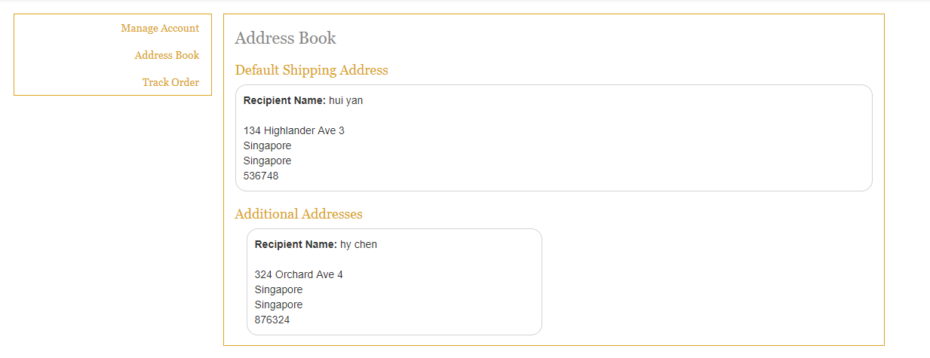
UAT1 – Customer Changes
Implemented an address book for customer to manage their address

Slide 48
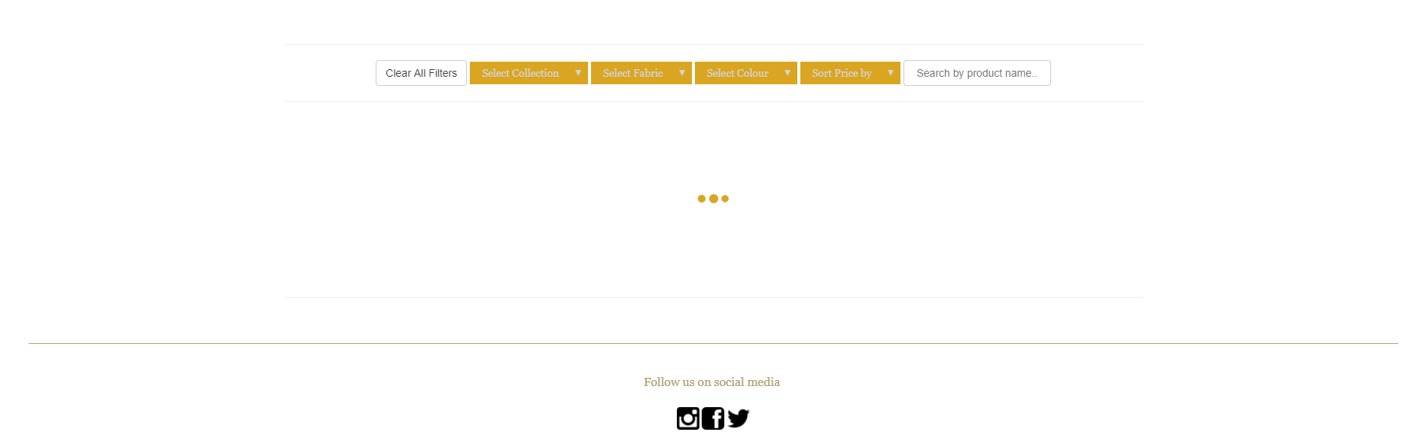
UAT1 – Customer Changes
Added animation to show that the page is loading

Slide 49
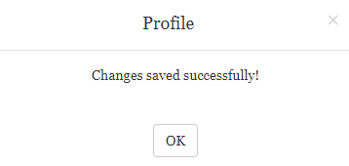
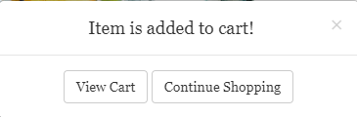
UAT1 – Customer Changes
Pop up notification to notify users on successful action performed

Slide 50

User Test - Administrator
Date: 20/8/2017 (Sunday)
Time: 3pm
Duration: ~30 minutes per user
Venue: SMU School of Law, B1.05 – GS
Objectives:
1. To gather feedback about the usability, user interface and function developed for the administrators
Identify any bugs or issues which administrators might face during the user testing
To detect usability issues based on administrator’ behaviour
Improve the website according to administrator feedbacks

Slide 51
User Test - Administrator
Key Findings:
Administrator do not know whether their edits are being saved successfully. (Success message not prominent)
Administrator do not know whether a new pattern is added successfully. (Success message not prominent)

Slide 52


UAT1 – Customer Ratings
Average rating on user interface

Slide 53
UAT1 – Customer Ratings
Average rating on ease of editing existing pattern details?

Slide 54
UAT1 – Customer Ratings
Average rating on ease of adding a new pattern

Slide 55

User Testing 2
9th October 2017

Slide 56




X - Factor
Processing
10 Transactions worth $4000
Both the Team and Client are confident of hitting the target by Finals
A Truly First of its Kind in Singapore
Virtual Reality in a Retail Store
Currently in
Development

Slide 57
Learning Outcome
Tee Yu Xuan
It is important to always be prepared by giving yourself enough room for some unpredictable situations.
“Anything that can go wrong, will go wrong” – Murphy’s Law

Slide 58
Learning Outcome
Jeremy Bachtiar
Through this FYP I wish to learn and experience working on a IT based project that aims to solve real business problems. Gained more understanding on managing and working in a development team. I also wish to learn more programming languages and develop application that follows a widely acceptable industry standard that will be useful for my future.

Slide 59
Team LeGIT
Clarissa Poedjiono
Through this project I wish to learn new technical skills as well as people skills. Working on FYP will give us exposure to developing IT project in a larger scale which would be beneficial to add on our experience before going out to the workforce, and hence I hope I can make the experience doing FYP a stepping stone for my future career.

Slide 60
Team LeGIT
Chen Huiyan
My first learning outcome is to learn some new technology or skills and it is quite exciting to learn Angular4 which allows us to develop an app with a new structure. Second objective is to gain experience of building an app as a full-stack developer in order to make myself more prepared for the industry. The last one is to learn some soft skills like how to work with different people and how to make the project run more smoothly.

Slide 61
Team LeGIT
Sheryl Chong Man Er
As quality assurance, i hope to be more detail orientated and looking at our application through our client and target audiences' eyes to identify multiple scenarios and corner cases to catch potential bugs in order to deliver an application of high quality. I hope this project will improve my interpersonal skills and critical thinking.

Slide 62
Team LeGIT
Ong Yi Xuan
As the software architect of the team, I have learnt a lot from this real life project, from picking the front and backend framework, designing a scalable database and making use of RESTful webservices for sending of data. Besides having a functional application that is usually required of us in school projects, we have to consider other real problems like performance, error handling and security aspects. This project have helped me piece what I learnt in IS all together and helped me see what I am lacking of.

Slide 63


IS480 Mid-Term

